Slide 1
Views in Postgres

Slide 2
Problem Statement [Medium Level]
A company maintains customer information, product information, and sales order information in three separate tables: customer_master, product_catalog, and sales_orders.
The company wants to provide an order report to an external client. The report must contain the Order ID, Order Date, Customer Name, Product Name, and Final Amount.
For every order, first calculate the Gross Amount using:
Gross Amount = Unit Price × Quantity
Then calculate the Discount Amount using:
Discount Amount = Gross Amount × Discount Percentage / 100
Finally, calculate the Final Amount using:
Final Amount = Gross Amount − Discount Amount
Create a complex view using the three tables to generate this report. The view should expose only the required five columns and should not expose the customer's phone/email, product brand/unit price, or the order's quantity/discount percentage.
The company also wants to provide access to an external client. Create a PostgreSQL user named client_user and give this user only SELECT permission on the view. The client must not have direct access to the three original tables and must not be allowed to modify the view data.

Slide 3
Problem Statement [Medium Level]
customer_id | full_name | city
C1 | Amit Sharma | Delhi
C2 | Priya Verma | Mumbai
C3 | Ravi Kumar | Bangalore
C4 | Neha Singh | Kolkata
C5 | Arjun Mehta | Hyderabad
product_id | product_name | unit_price
P1 | Smartphone X100 | 25000
P2 | Laptop Pro 15 | 65000
P3 | Wireless Earbuds | 5000
P4 | Smartwatch Fit | 30000
P5 | Gaming Console | 45000
customer_master
product_catalog

Slide 4
Problem Statement [Medium Level]
order_id | product_id | quantity | customer_id | discount_percent | order_date
1 | P1 | 2 | C1 | 5 | 2025-09-01
2 | P2 | 1 | C2 | 10 | 2025-09-02
3 | P3 | 3 | C3 | 0 | 2025-09-03
4 | P4 | 1 | C4 | 8 | 2025-09-04
5 | P5 | 1 | C5 | 12 | 2025-09-05
6 | P1 | 1 | C2 | 5 | 2025-09-06
7 | P3 | 2 | C1 | 0 | 2025-09-07
sales_orders

Slide 5
Problem Statement [Medium Level]
order_id | order_date | full_name | product_name | final_amount
1 | 2025-09-01 | Amit Sharma | Smartphone X100 | 47500.00
2 | 2025-09-02 | Priya Verma | Laptop Pro 15 | 58500.00
3 | 2025-09-03 | Ravi Kumar | Wireless Earbuds | 15000.00
4 | 2025-09-04 | Neha Singh | Smartwatch Fit | 27600.00
5 | 2025-09-05 | Arjun Mehta | Gaming Console | 39600.00
6 | 2025-09-06 | Priya Verma | Smartphone X100 | 23750.00
7 | 2025-09-07 | Amit Sharma | Wireless Earbuds | 10000.00
Expected Output – In the Form of a View

Slide 6
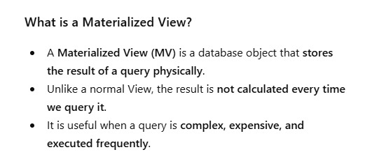
Materialized Views in Postgres

Slide 7
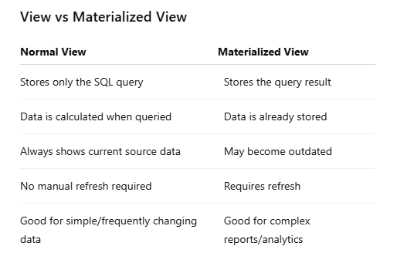
Materialized Views in Postgres

Slide 8
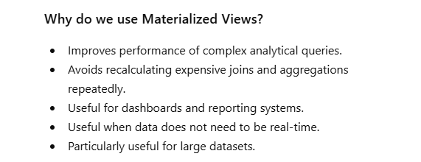
Materialized Views in Postgres

Slide 9
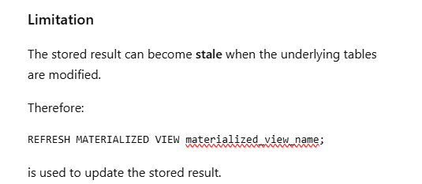
Materialized Views in Postgres

Slide 10
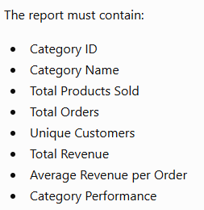
Problem Statement [Hard Level]
An e-commerce company wants to regularly analyze the performance of its product categories.
The company stores product, category, customer, and order information in separate tables. To generate the category performance report, the database needs to perform multiple JOINs, GROUP BY, aggregate functions, DISTINCT counting, calculated values, and CASE statements.
Since the same report is generated frequently, executing the complete analytical query every time can increase database workload.
Create a PostgreSQL Materialized View named: mv_category_sales
Also demonstrate that when new order data is inserted, the Materialized View does not automatically reflect the change and must be refreshed.
Finally, use EXPLAIN ANALYZE to compare the performance of the original analytical query with the Materialized View query.

Slide 11
Problem Statement [Hard Level]
Business Rules
Requirement | Rule
Total Products Sold | SUM(quantity)
Total Orders | COUNT(DISTINCT order_id)
Unique Customers | COUNT(DISTINCT customer_id)
Total Revenue | SUM(quantity × unit_price)
Average Revenue per Order | Total Revenue / Total Orders
Excellent | Revenue ≥ 10,000
Good | Revenue ≥ 6,000 and < 10,000
Average | Revenue ≥ 3,000 and < 6,000
Low | Revenue < 3,000

Slide 12
Problem Statement [Hard Level]
Tasks
Task | Description
1 | Create the required source tables.
2 | Insert the given category, product, customer, and order data.
3 | Write a query to generate the category-wise sales report.
4 | Execute the query using EXPLAIN ANALYZE.
5 | Create the Materialized View mv_category_sales.
6 | Display the data from the Materialized View.
7 | Execute EXPLAIN ANALYZE on the Materialized View query.
8 | Compare the execution time of both queries.
9 | Insert a new order and order detail.
10 | Query the Materialized View before refreshing it and observe the stale data.
11 | Refresh the Materialized View.
12 | Query the Materialized View again and verify the updated result.

Slide 13
Problem Statement [Hard Level]
category_master
product_master
category_id | category_name
C1 | Electronics
C2 | Clothing
C3 | Books
product_id | product_name | category_id
P101 | Laptop | C1
P102 | Headphones | C1
P201 | Jacket | C2
P202 | Shoes | C2
P301 | SQL Book | C3
customer_master
customer_id | customer_name
U1 | Aman
U2 | Priya
U3 | Rahul
U4 | Simran

Slide 14
order_details
order_id | customer_id | product_id | quantity | unit_price
O101 | U1 | P101 | 1 | 5000
O102 | U2 | P102 | 2 | 1000
O103 | U1 | P201 | 1 | 3000
O104 | U3 | P202 | 2 | 2000
O105 | U4 | P301 | 3 | 500
O106 | U2 | P101 | 1 | 5000
O107 | U3 | P201 | 1 | 3000
O108 | U4 | P102 | 1 | 1000

Slide 15
Output
category_id | category_name | total_products_sold | total_orders | unique_customers | total_revenue | avg_revenue_per_order | category_performance
C1 | Electronics | 5 | 4 | 3 | 12000 | 3000.00 | Excellent
C2 | Clothing | 4 | 3 | 2 | 10000 | 3333.33 | Excellent
C3 | Books | 3 | 1 | 1 | 1500 | 1500.00 | Low

